Slide 1
Inheritance
Section 2
Chapter 7
© 2016 Pearson Education, Ltd. All rights reserved.

Slide 2
Inheritance
Inheritance is a feature of object-oriented programming
Allows us to define a new class
  Called the subclass, child class, or derived class
  A modified version of an existing class (called the superclass, parent class, or base class)
Subclass inherits properties and methods of the superclass
  Adding some of its own properties and methods
  Overriding some of the superclass' methods
© 2016 Pearson Education, Ltd. All rights reserved.

Slide 3
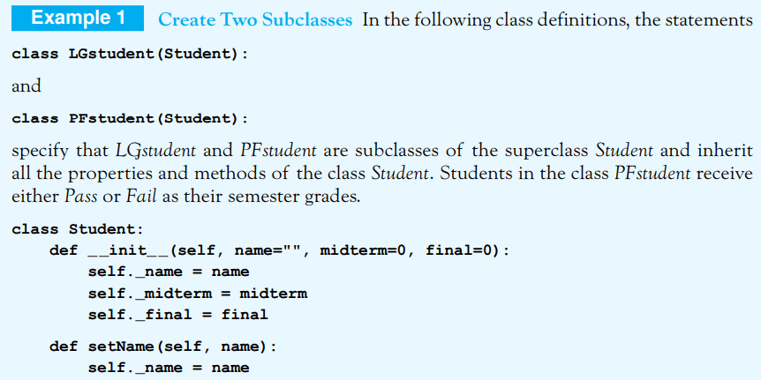
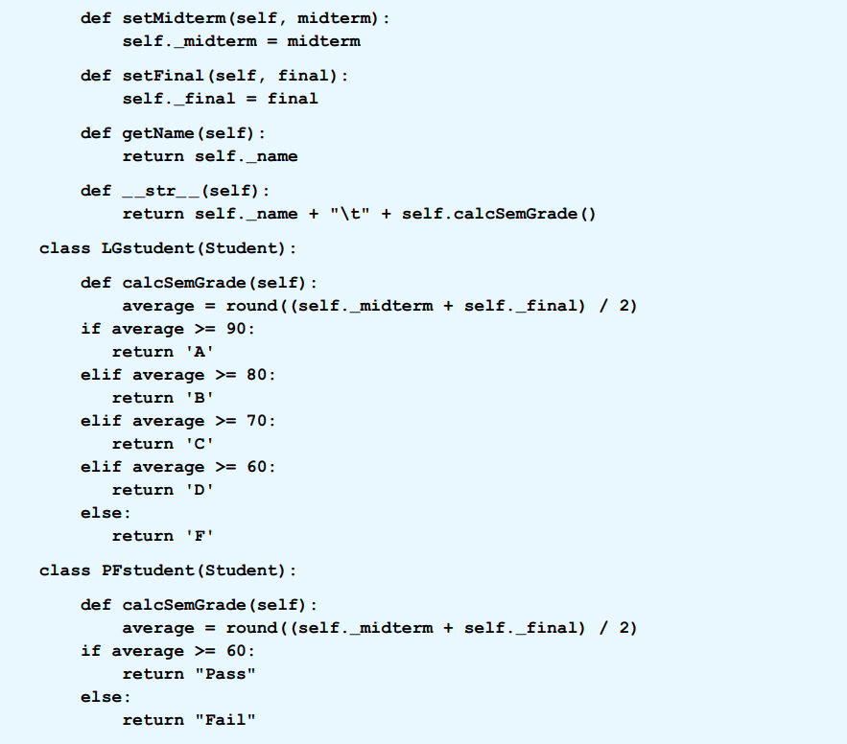
Consider the class LGstudent presented in Example 5 of Section 7.1.
LGstudent could have been defined as a subclass of a superclass named Student:

Slide 4
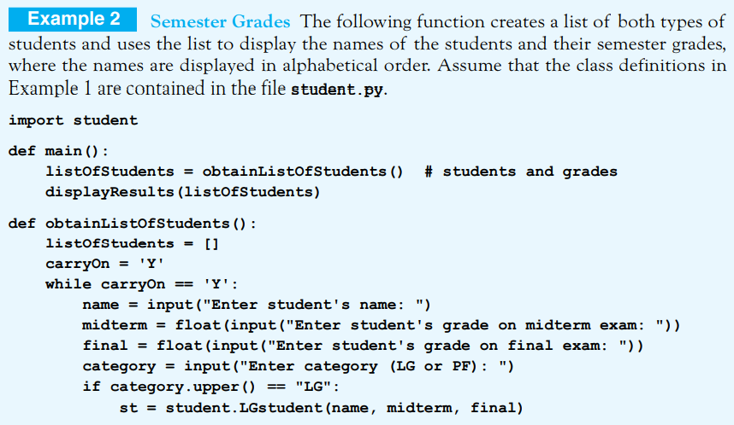
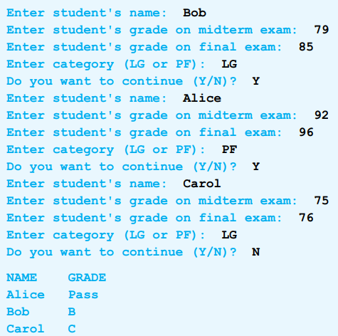
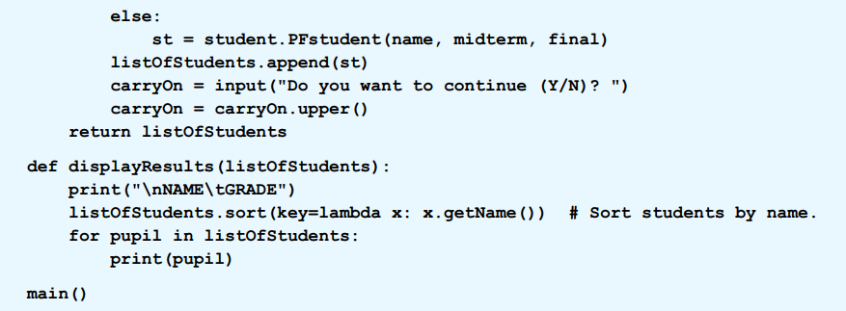

Slide 5
The "is-a" Relationship
Child classes are specializations of their parent's class.
  They have all the characteristics of their parents
  But have more functionality
  Each child satisfies the "is-a" relationship with the parent
For instance, consider Example 2.
  Each letter- grade student is a student.
  Similarly, each pass-fail student is a student.

Slide 6
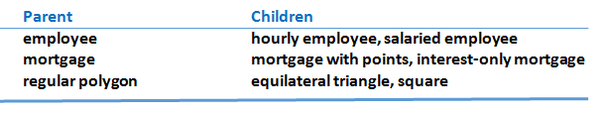
The "is-a" Relationship
In each pair,
  The child is a specialized version of the parent
  and each child satisfies the “is-a” relationship with the parent
Some parent–child pairs appearing in the exercises are shown below:
Table 1 Some parent-child pairs.
© 2016 Pearson Education, Ltd. All rights reserved.

Slide 7
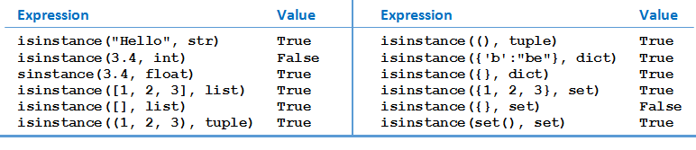
The isinstance Function
A statement of the form:
isinstance(object, className)
returns True if object is an instance of the named class or any of its subclasses, and otherwise returns False.
The isinstance function can be applied to both built-in and user-defined classes. Table shows the values of some expressions involving the isinstance function:
Table 2 Some expressions involving the isinstance function.
© 2016 Pearson Education, Ltd. All rights reserved.

Slide 8
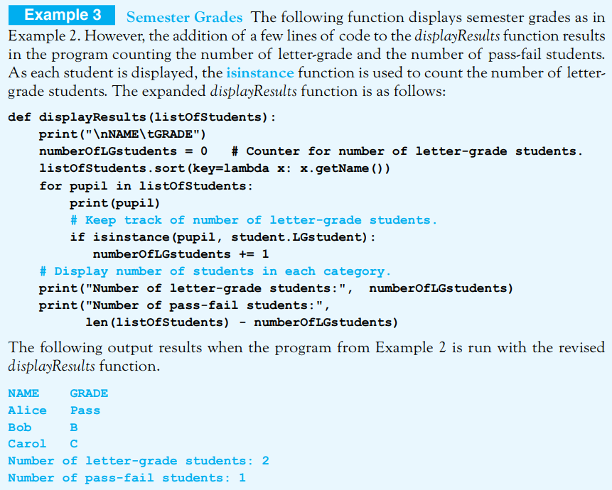
The isinstance Function
© 2016 Pearson Education, Ltd. All rights reserved.

Slide 9
Adding New Instance Variables to a Subclass
So far, the child classes in our examples have only added functions to their parent classes.
  However, they can also add properties, that is, instance variables.
  In that situation, the child class must contain an initializer method which draws in the parent’s properties and then adds its own new properties.
The parameter list in the header of the child’s initializer method should begin with self, list the parent’s parameters, and add on the new child’s parameters. The first line of the block should have the form:
super().__init__(parentParameter1, . . . , parentParameterN)
This line should be followed by standard declaration statements for the new parameters of the child.

Slide 10
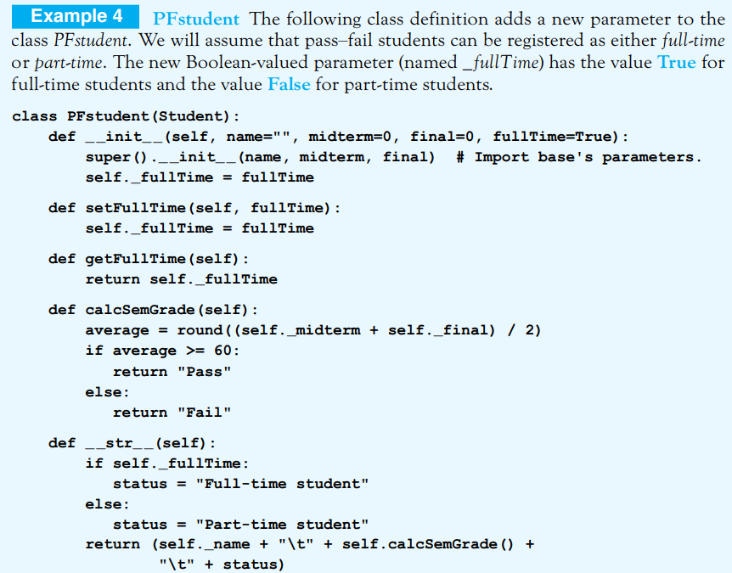

Slide 11
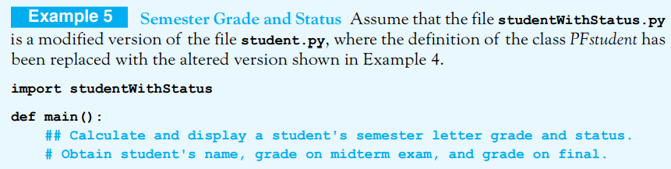
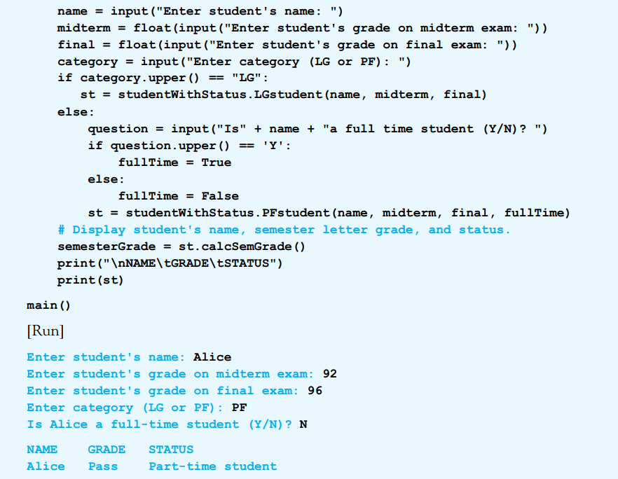

Slide 12
Overriding a Method
A subclass can change the behavior of an inherited method.
If method defined in subclass has same name as a method in its superclass
  Child's method will override parent's method
© 2016 Pearson Education, Ltd. All rights reserved.

Slide 13
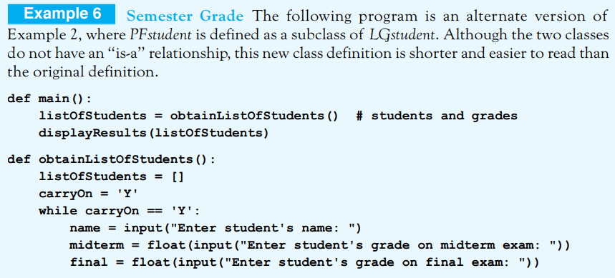
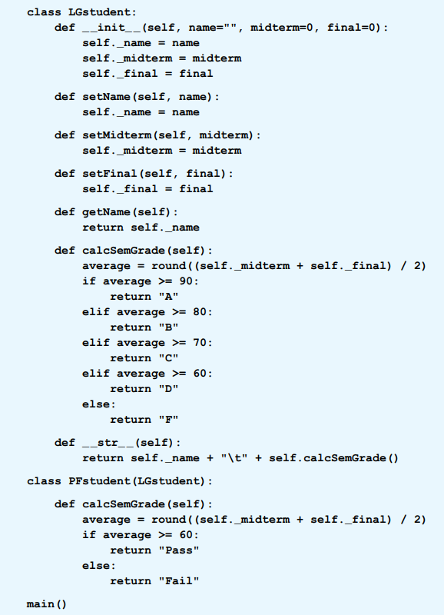
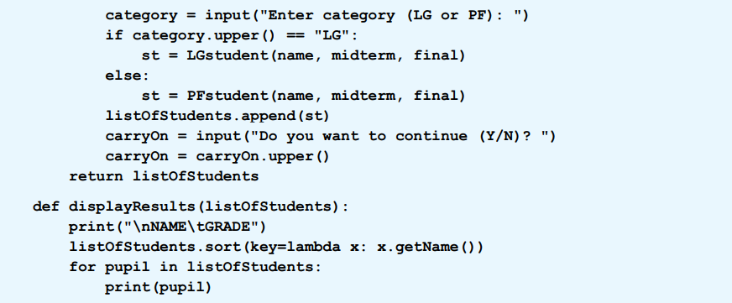

Slide 14
Polymorphism
In Example 1, the child classes LGstudent and PFstudent have calcSemGrade methods with the same header but with different definitions.
The feature of Python (and every object-oriented programming language) that allows two classes to use the same method name (but with different implementations) is called polymorphism.
The program in Example 2 adjusts the implementation of the calcSemGrade method depending on the type of object that calls it.
The word polymorphism is derived from a Greek word meaning “many forms.”

Slide 15
End
Section 2
Chapter 7
© 2016 Pearson Education, Ltd. All rights reserved.

